Slide 1

COMMUNITY STRUCTURE IN NETWORKS: AN IMPROVED GIRVAN-NEWMAN ALGORITHM
Master of Computer Applications
Submitted by
ABHISHEK
14/CA/638
Under the supervision of
Dr. Prasenjit Choudhury
Associate Professor
NIT DURGAPUR
Department of Computer Science and Engineering
National Institute Of Technology, Durgapur
May 2017

Slide 2
Table Content
Introduction
Motivation
Structural Property
Algorithm and work
Network Characteristics
Result
Conclusion and future work

Slide 3
Introduction
Significant advances to our understanding of complex networks.
Most relevant feature of graphs is community structure.
Detecting communities is of great importance.

Slide 4
What is Community ?
No universal definition.
Group of vertices sharing common properties.
Groups of nodes with dense connections internally and sparse connections between groups.
In case of Social Networking sites, e.g. Facebook, community might represent people with common interest.

Slide 5
Community Detection : Finding the communities
It’s the process of finding community structure in a network.
The first community detection algorithm that dealt efficiently is Girvan-Newman.
Others are ScaleFreeCDA, Louvian Algorithm.

Slide 6
Why is it important ?
To set up efficient recommendation systems.
In social network, a good CDA helps in connecting people.
Detection of vulnerable nodes and links of a communication network.
In transport network, identifying key transport hubs.

Slide 7
Structural properties of a network
Degree Centrality gives measure of node importance.
Betweenness Centrality is the number of shortest paths between pairs of nodes that run along it.
Closeness Centrality is the measure of the degree to which an individual is near all other individuals in network.
Modularity tells us how good a partition is.

Slide 8
Girvan-Newman Algorithm
It’s one of the first algorithm to deal with community detection.
It’s divisive method.
Uses Edge-Betweenness Centrality.
Time complexity is O(m²n).

Slide 9
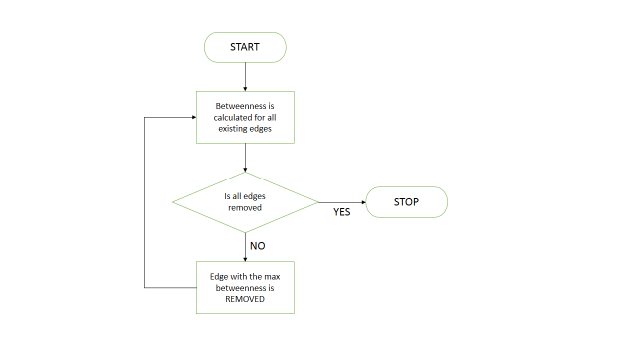
Girvan-Newman Algorithm cont.
Flowchart of Girvan-Newman

Slide 10
Girvan-Newman Algorithm cont.
Disadvantage
Not really an algorithm.
Labelling of vertices impacts result.
For sparse networks it runs very slow. It takes O(n³)

Slide 11
Girvan-Newman improved version
Divisive method.
Uses Edge-Betweenness.
Modularity tells the optimal decomposition of network
Local maxima of modularity is the decision maker.

Slide 12
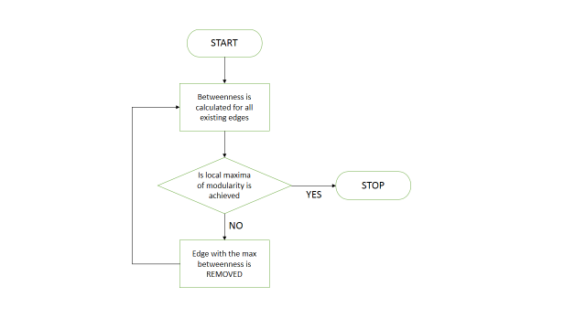
Girvan-Newman improved version cont.
Flowchart of Girvan-Newman improved version

Slide 13
Girvan-Newman improved version cont.
Advantage
Introduces the concept of modularity.
Reduced number of operations.

Slide 14
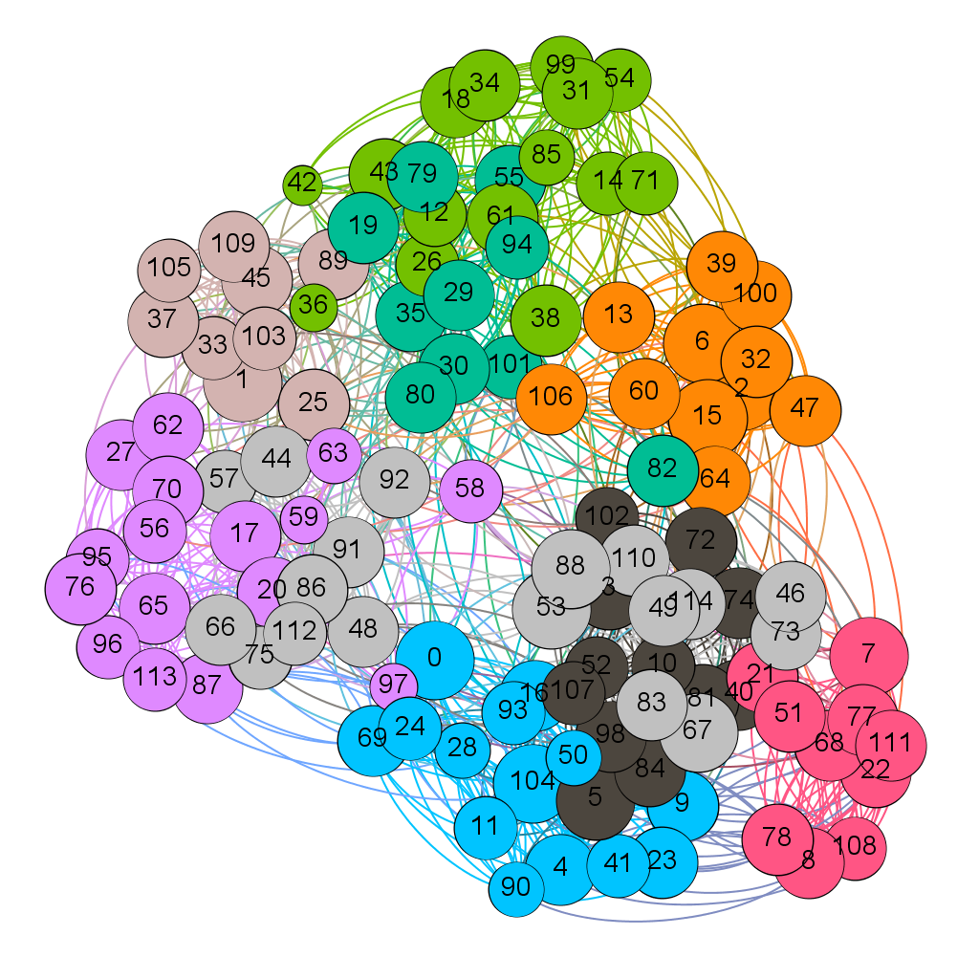
Network characteristics
Football Network
American Football College collected by Girvan-Newman
Nodes represent teams(115 teams).
Edges represent end-points have disputed a match(613 matches).

Slide 15
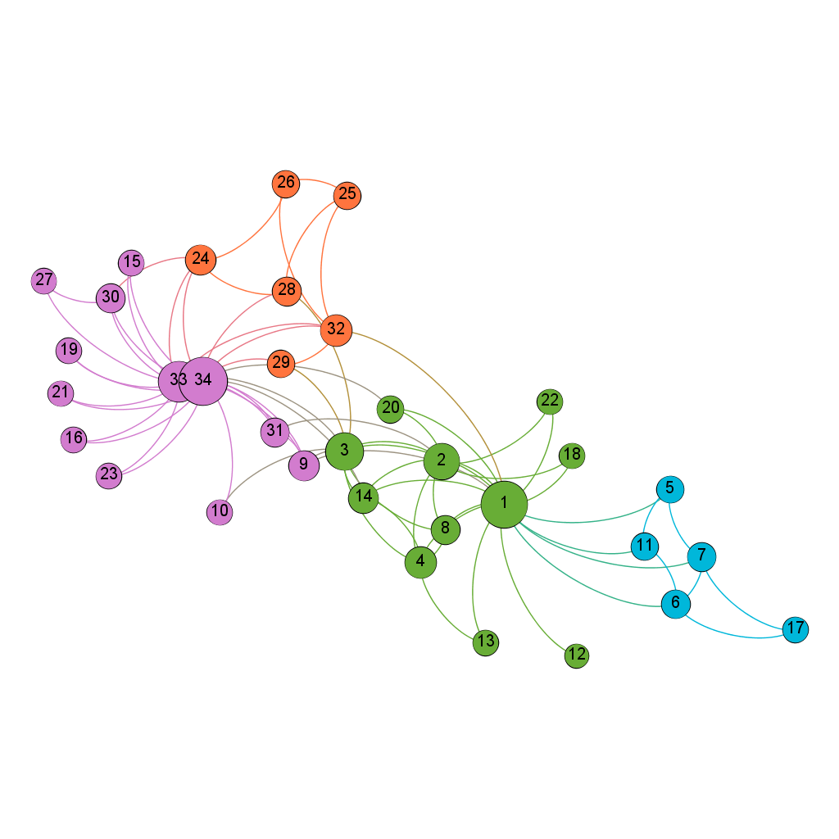
Network characteristics cont.
Zachary’s Karate Club
Network captures 34 members.
78 edges represent interaction between members.
Conflict between administrator led to the split of club.

Slide 16
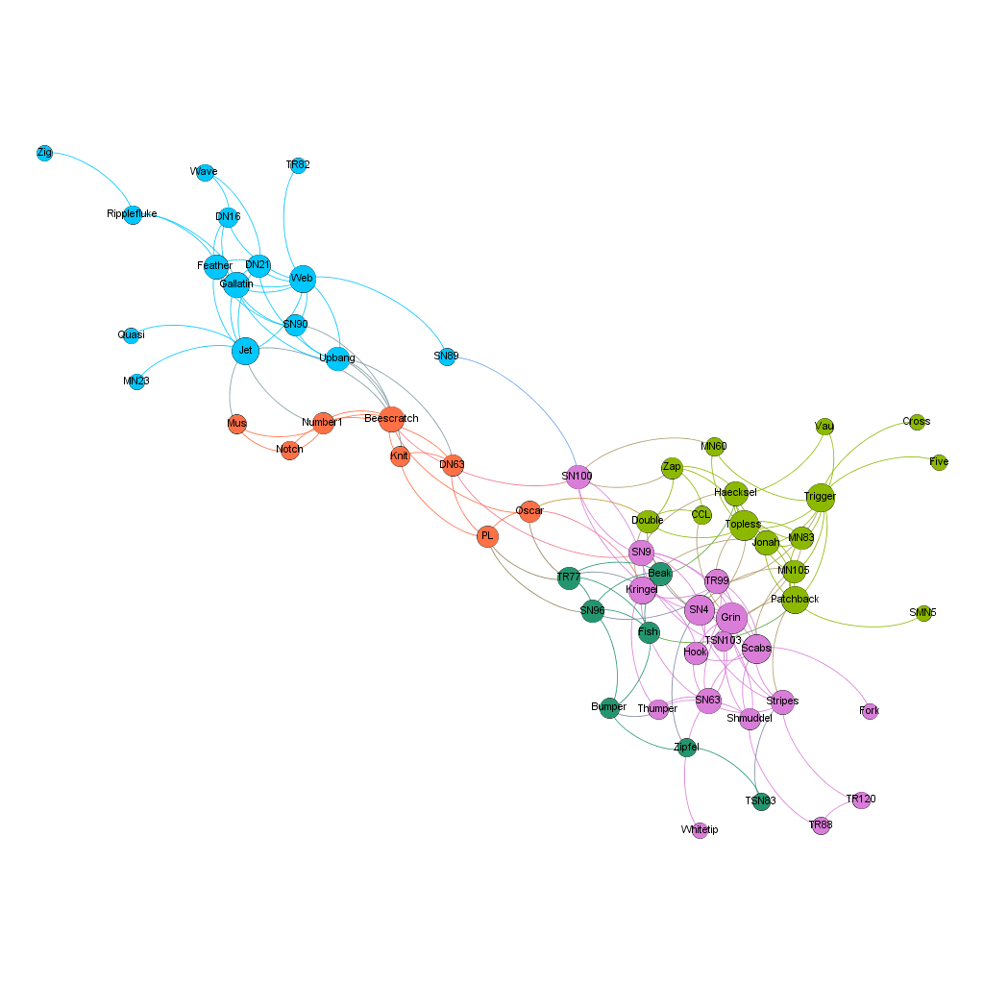
Network characteristics cont.
Dolphins Network
Network captures 62 dolphins in Doubtful Sound, NZ.
Edges represent close association between dolphins.

Slide 17
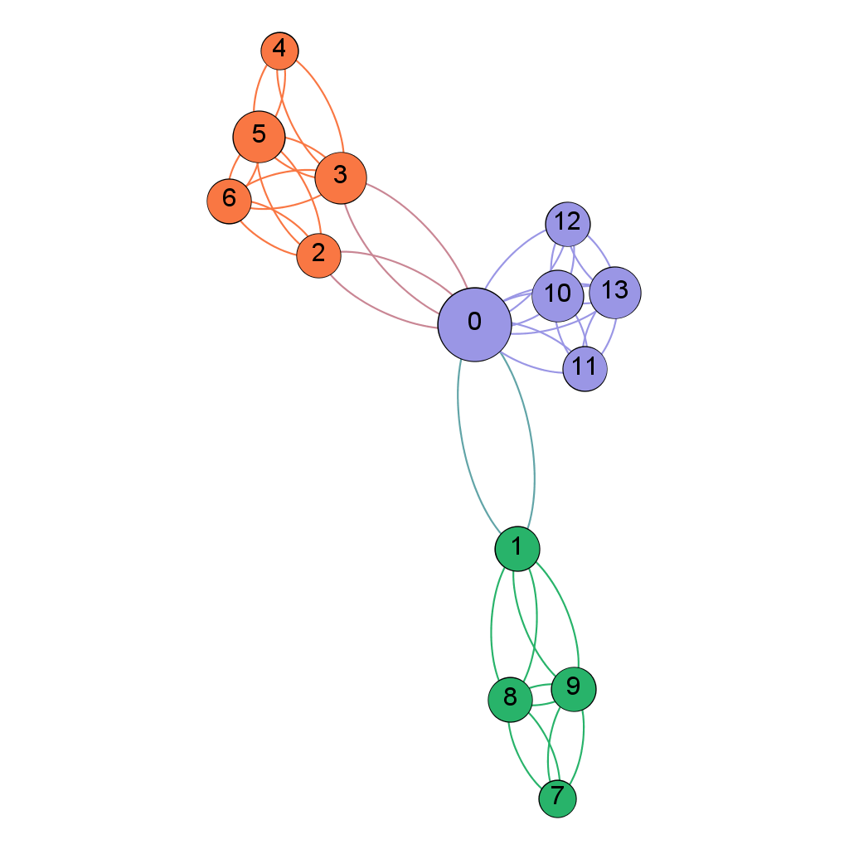
Network characteristics cont.
Toy Network
Network has 14 nodes.
It has 48 edges.

Slide 18
Community detection using seven CDAs
Ran community detection algorithm on above networks.
We find there is slight deviation between number of communities discovered and actual communities.
The reason is all CDAs are unique in terms of parameter they are using to get the communities discovered.

Slide 19
Community detection using seven CDAs cont.
Real Networks | Number of Nodes/Edges/Real Communities | Number of communities detected by the seven algorithms
Football network | 115/613/12 | 10/6/12/10/12/10/13
Zachary’s network | 34/78/2 | 5/3/3/4/3/4/2
Dolphin’s network | 62/159/2 | 5/4/5/5/6/5/4
Simple Network I | 14/48/3 | 3/3/3/3/3/3/3
Simple Network II | 13/22/2 | 4/4/3/2/2/4/3
Simple Network III | 14/17/4 | 6/4/6/6/4/6/6
SUMMARY OF NETWORK DATASETS AND THE NUMBER OF COMMUNITIES DETECTED BY GIRVAN-NEWMAN, FAST GREEDY, LABEL PROPAGATION, LOUVAIN, INFOMAP, WALKTRAP AND IMPROVED GN ALGORITHM

Slide 20
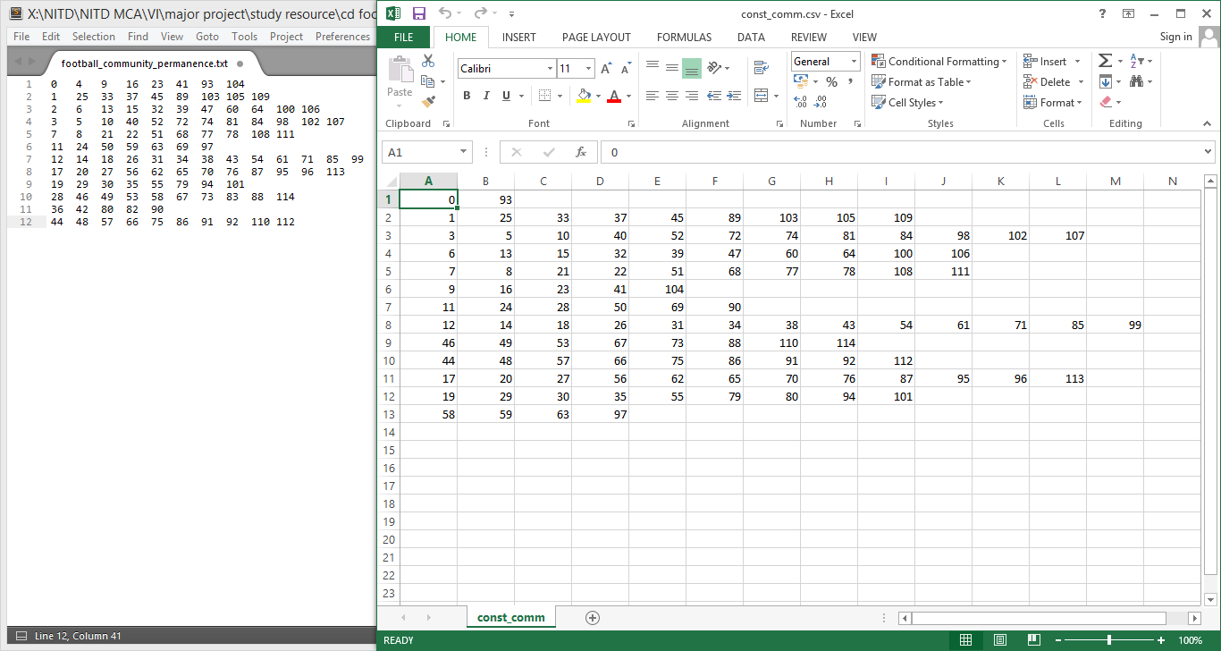
Constant community
The group of vertices that remain invariant as constant communities.
We performed analysis on football network with six CDAs
GIRVAN-NEWMAN, FAST GREEDY, LABEL PROPAGATION, LOUVAIN, INFOMAP AND WALKTRAP

Slide 21
Result
Discovered communities successfully and efficiently.
Our algorithm’s deviation from actual communities is less in comparison to GN’s result.
Our algorithm runs with reduced number of operations but retains same computational complexity as Girvan-Newman.

Slide 22
Conclusion and Future Work
Girvan-Newman suffers from “childhood diseases” and number of operation is proportional to m²n, or n³ for sparse networks.
Our improved algorithm runs with reduced number of operation but retains the same time complexity.
We need to tailor our algorithm to analyse some type of biological networks.
We need to test the reliability by using large dataset with 10000 or more number of nodes and edges.

Slide 23
Thank You !!!

